Slide 1
Deep Mixture Point Processes: Spatio-temporal Event Prediction with Rich Contextual Information
KDD 2019
张欣蕾 51194501083
2020-3-26

Slide 2
OUTLINE
Preliminaries
Motivation
Method
Experiments

Slide 3
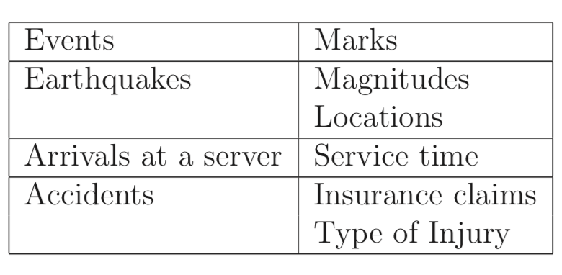
Temporal Point Process
A temporal point pattern is basically a list of times of event.
An essential tool for dealing with these mechanisms, for example in predicting future events, is a stochastic process modelling the point patterns: a temporal point process.

Slide 4
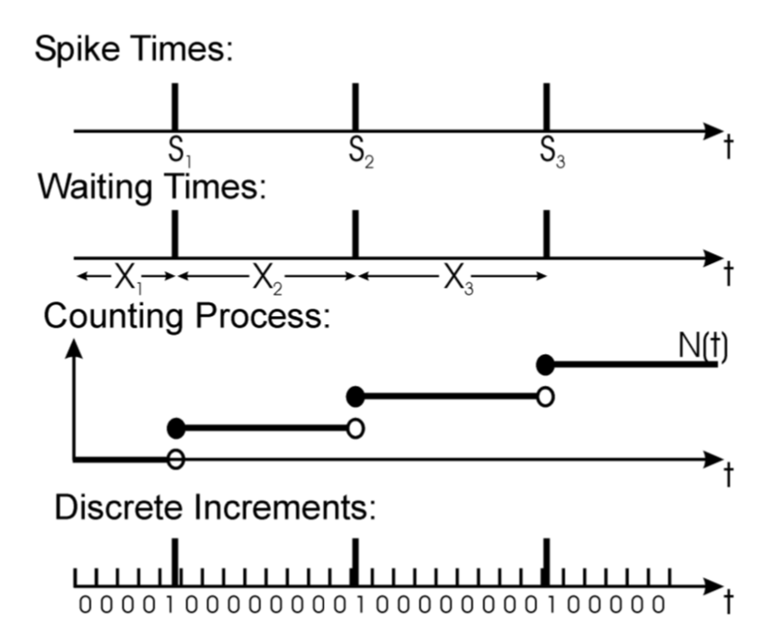
How to specify a temporal point process
Times
Waiting times
Counting
Discrete Increments

Slide 5
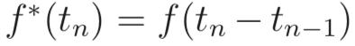
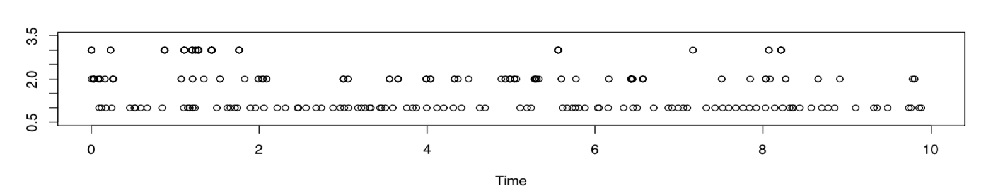
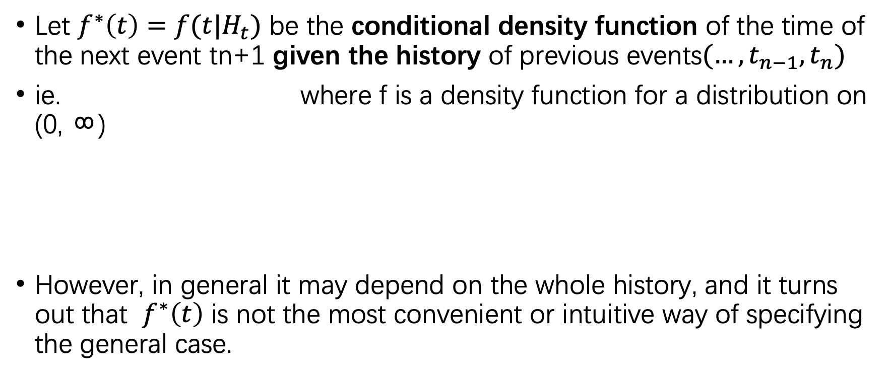
Conditional density function
Let $f^{∗}\left(t\right)=f(t|H_{t})$ be the conditional density function of the time of the next event tn+1 given the history of previous events$(…, t_{n−1},t_{n})$
ie. where f is a density function for a distribution on (0, ∞)
However, in general it may depend on the whole history, and it turns out that $f^{∗}\left(t\right)$ is not the most convenient or intuitive way of specifying the general case.

Slide 6
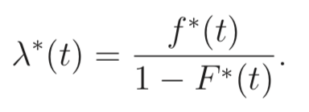
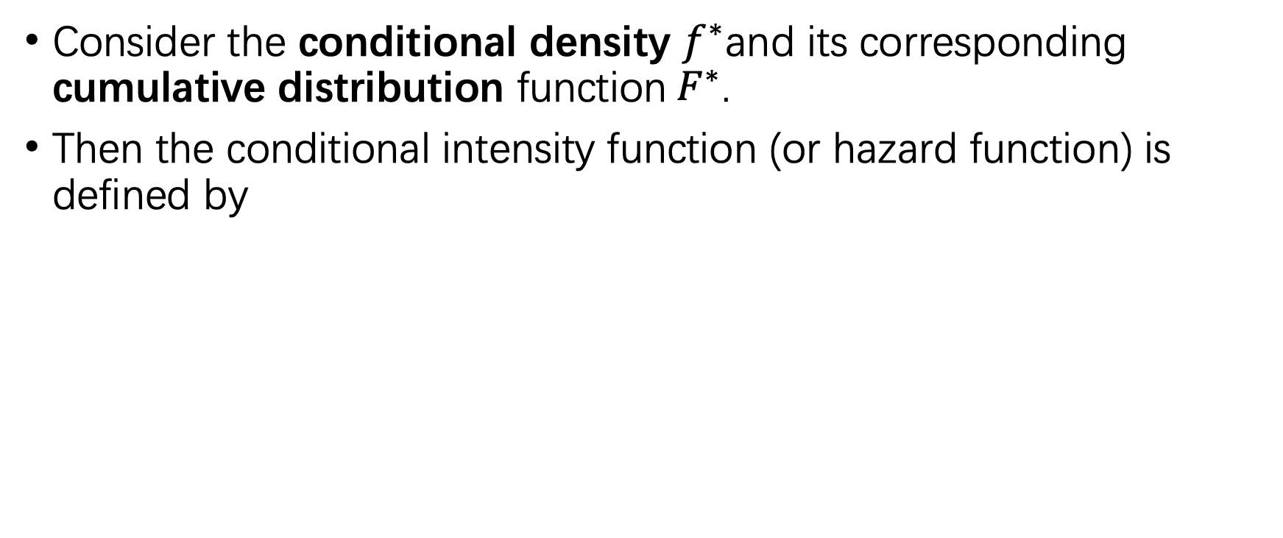
Conditional intensity function
Consider the conditional density $f^{∗}$and its corresponding cumulative distribution function${ F}^{∗}$.
Then the conditional intensity function (or hazard function) is defined by

Slide 7
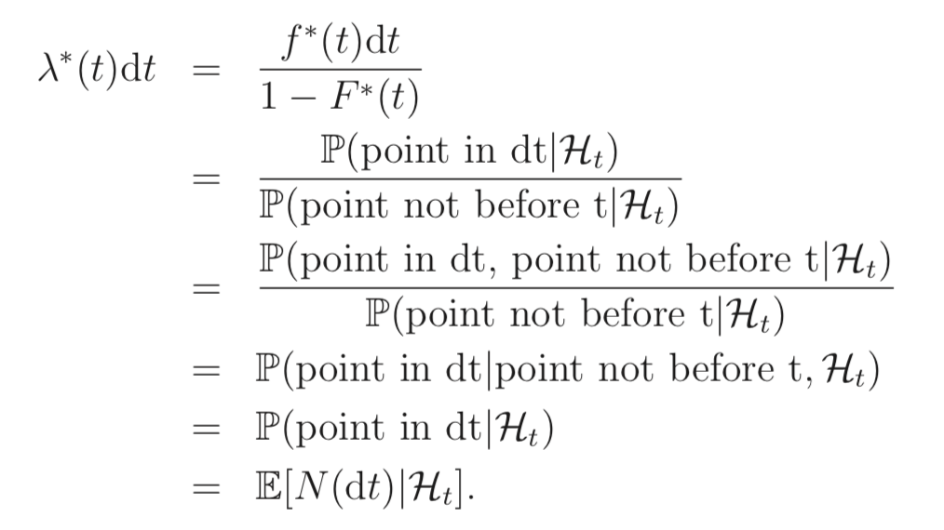
Heuristic interpretation of the conditional intensity function

Slide 8
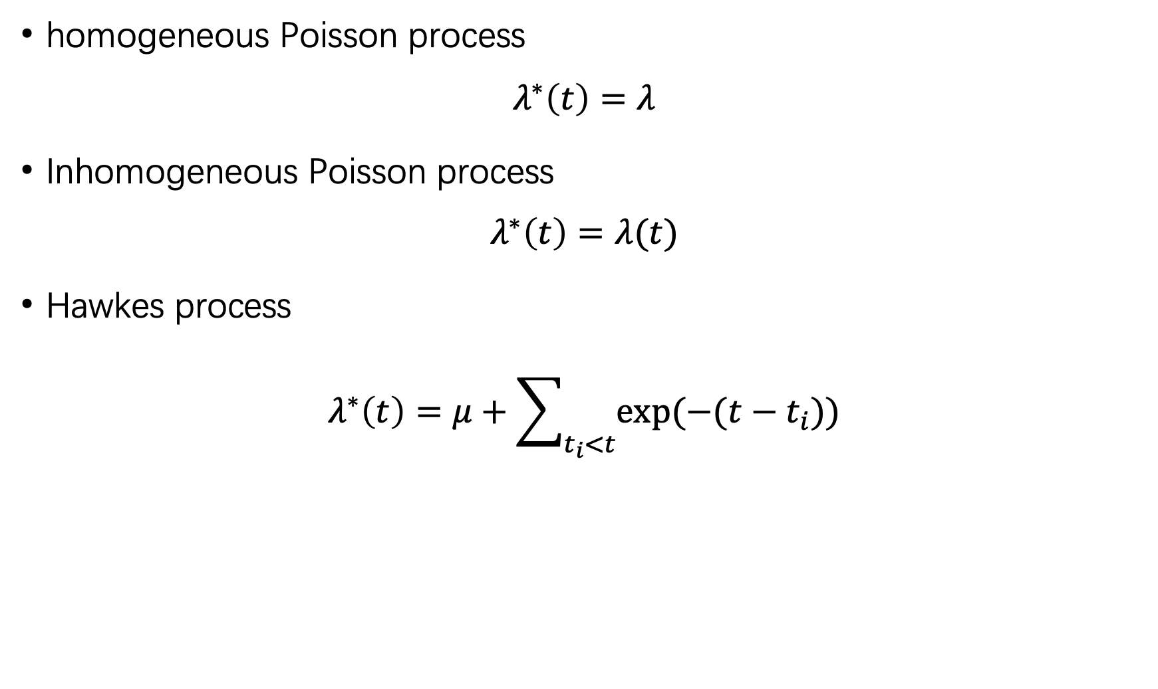
Examples
homogeneous Poisson process
$$λ^{∗}\left(t\right)=λ$$
Inhomogeneous Poisson process
$$λ^{∗}\left(t\right)=λ(t)$$
Hawkes process
$$λ^{∗}\left(t\right)=μ+\sum_{t_{i}<t}{exp⁡(−(t−t_{i}))}$$

Slide 9
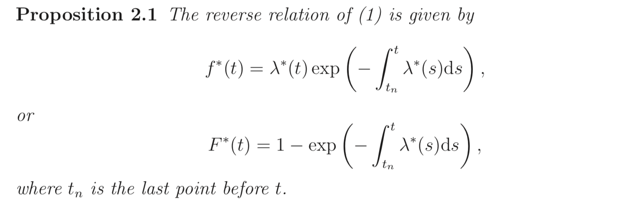
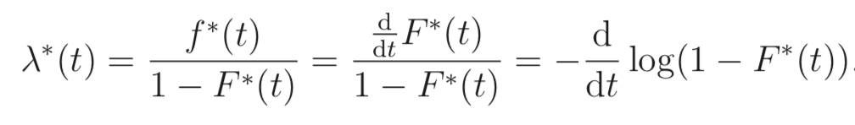
Inference

Slide 10
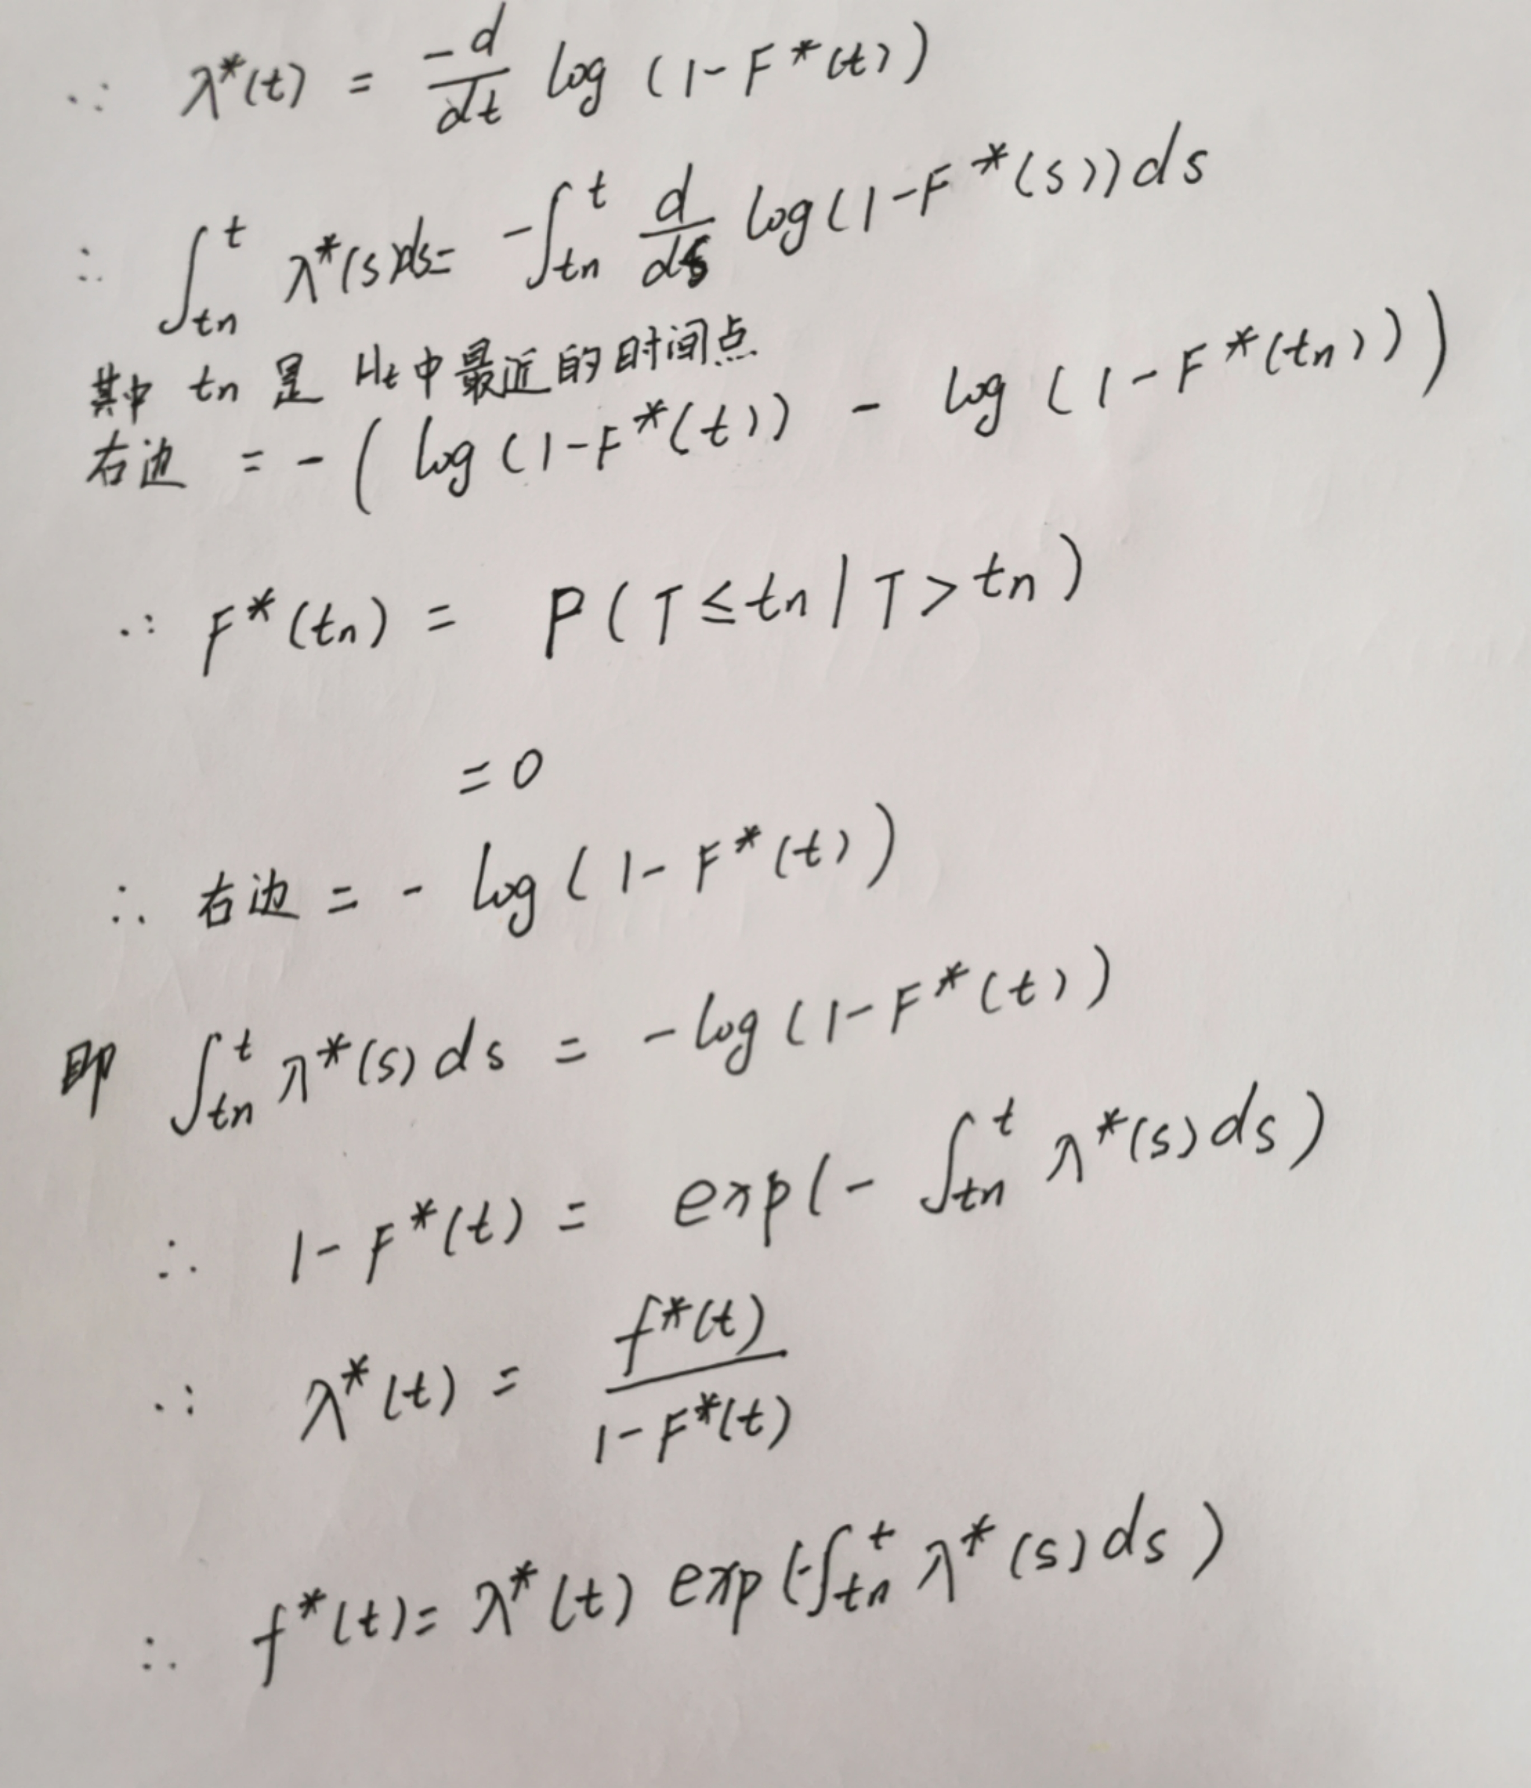
proof

Slide 11
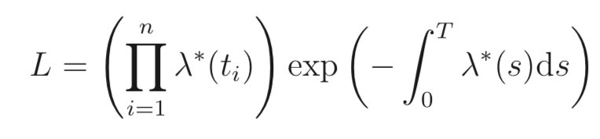
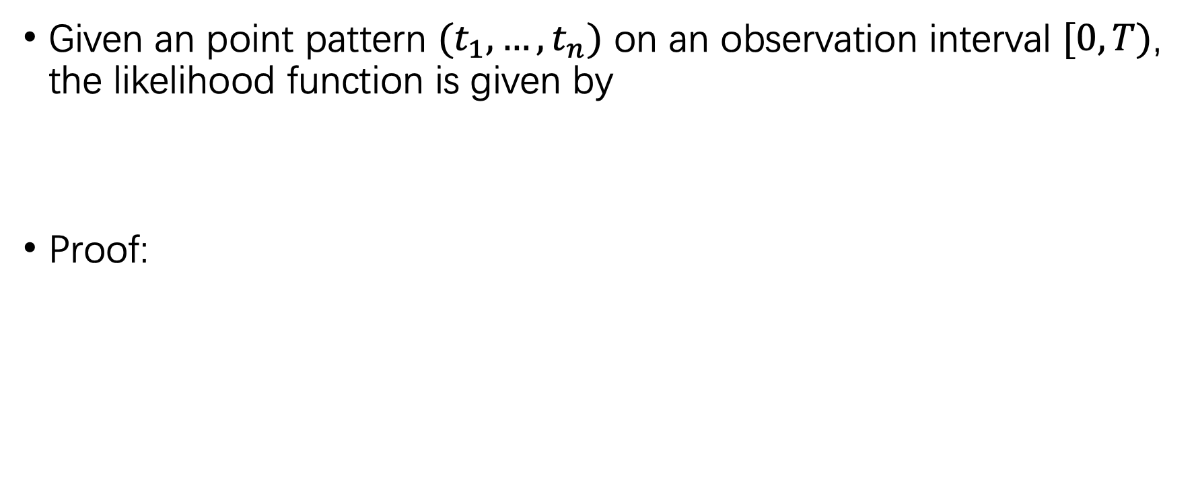
Inference
Given an point pattern $(t_{1},…,t_{n})$ on an observation interval $[0,T)$, the likelihood function is given by
Proof:

Slide 12
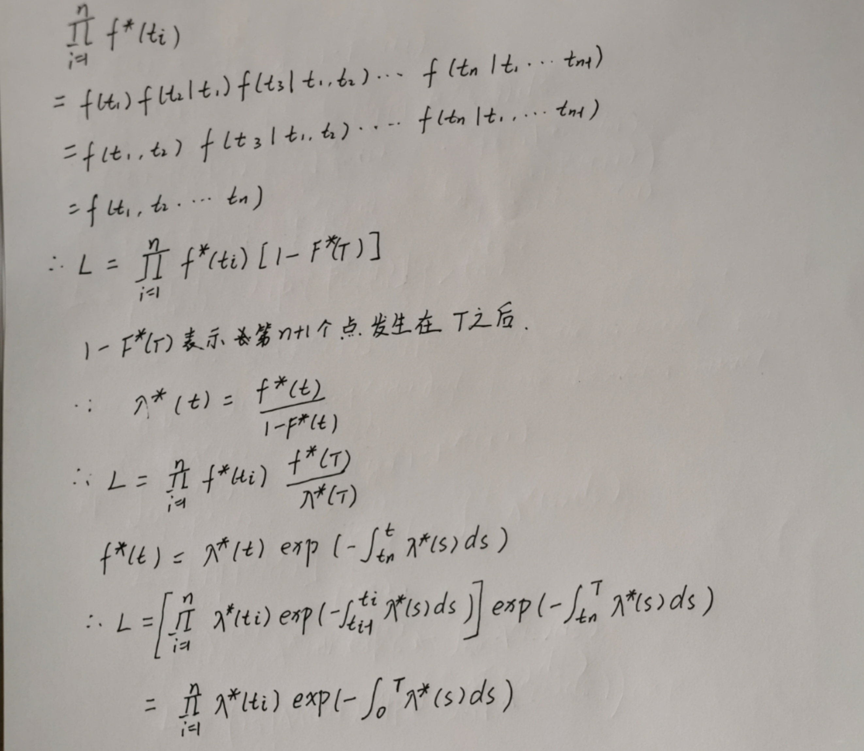
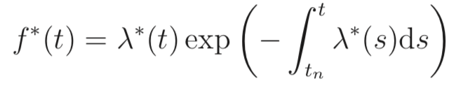
proof
代入

Slide 13
Summary

Slide 14
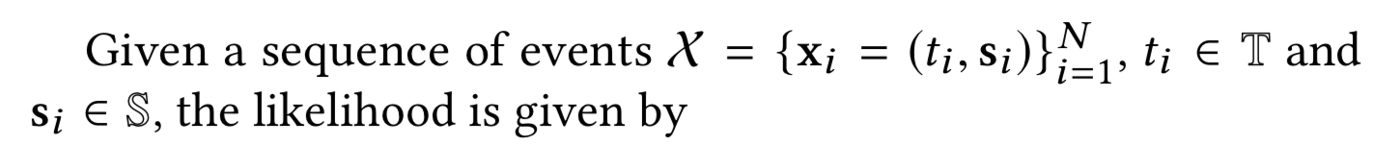
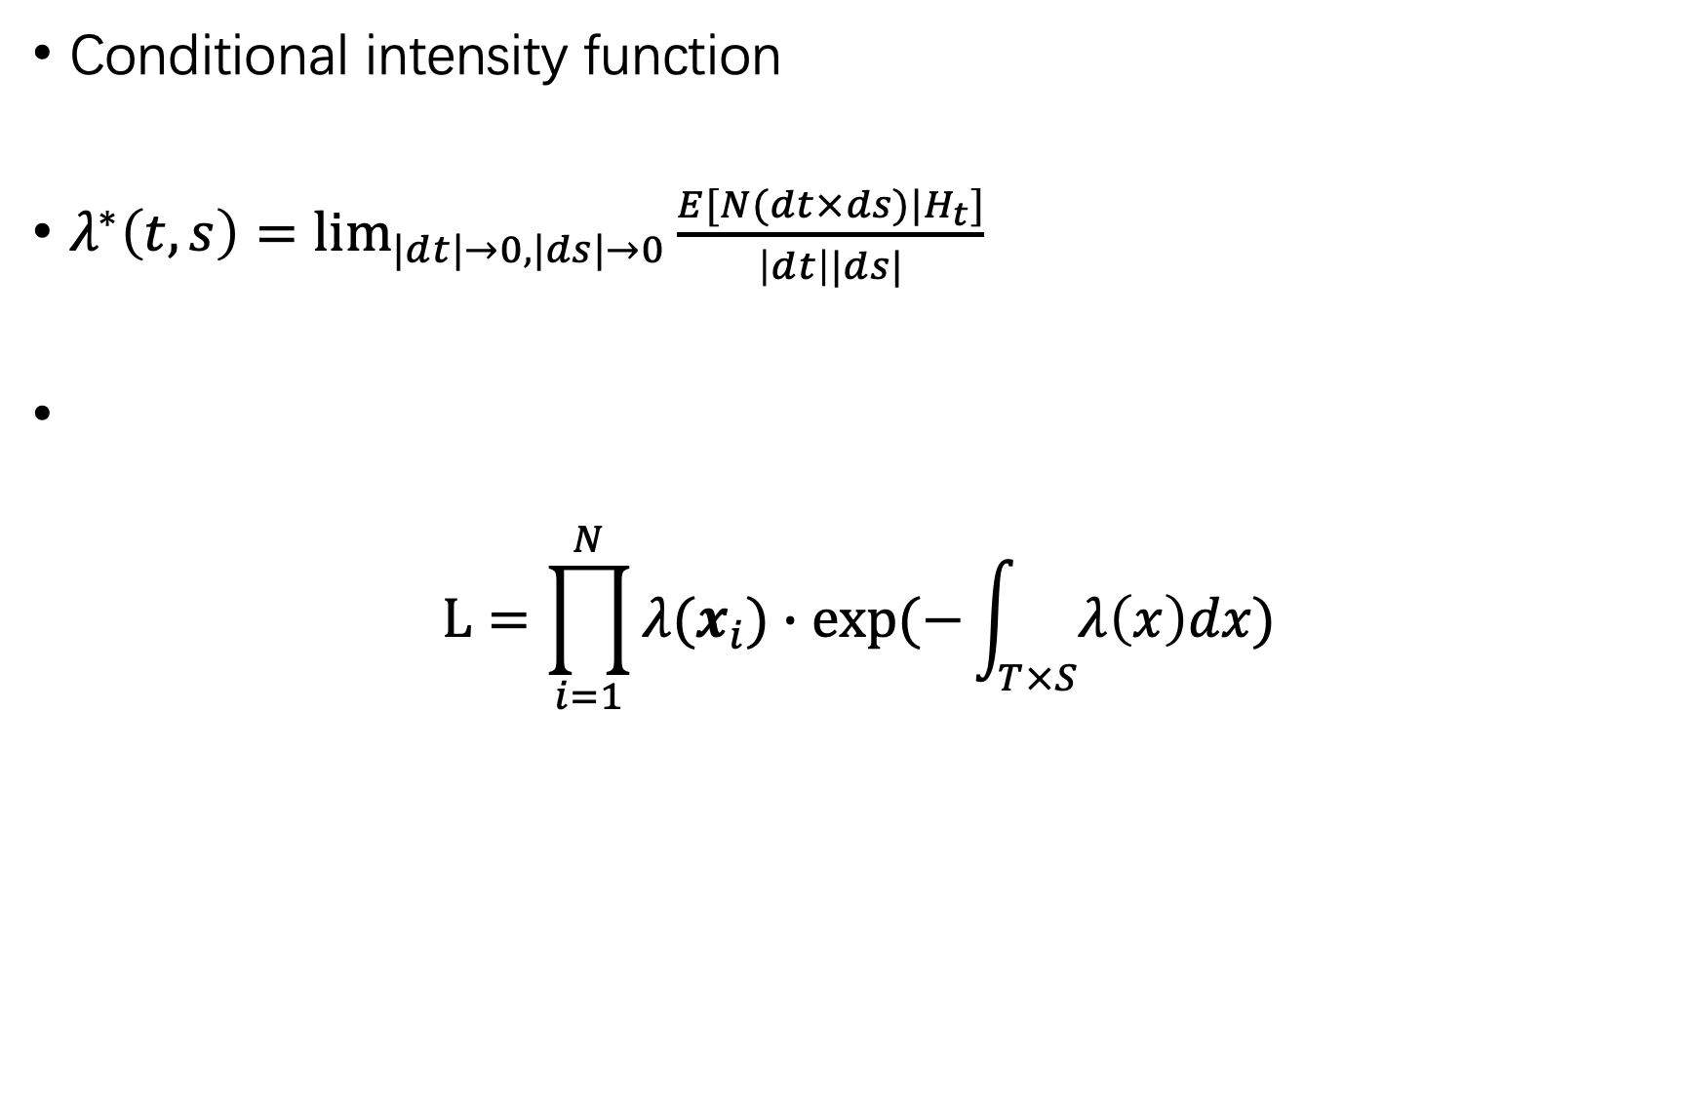
Spatio-Temporal Point Process
Conditional intensity function
$λ^{∗}\left(t,s\right)=\lim_{|dt|→0,|ds|→0}{\frac{E[N(dt×ds)|H_{t}]}{\left|dt\right||ds|}}$
$$L=\prod_{i=1}^{N}{λ(x_{i})∙exp⁡(−\int_{T×S}{λ\left(x\right)dx})}$$

Slide 15
OUTLINE
Preliminaries
Motivation
Method
Experiment

Slide 16
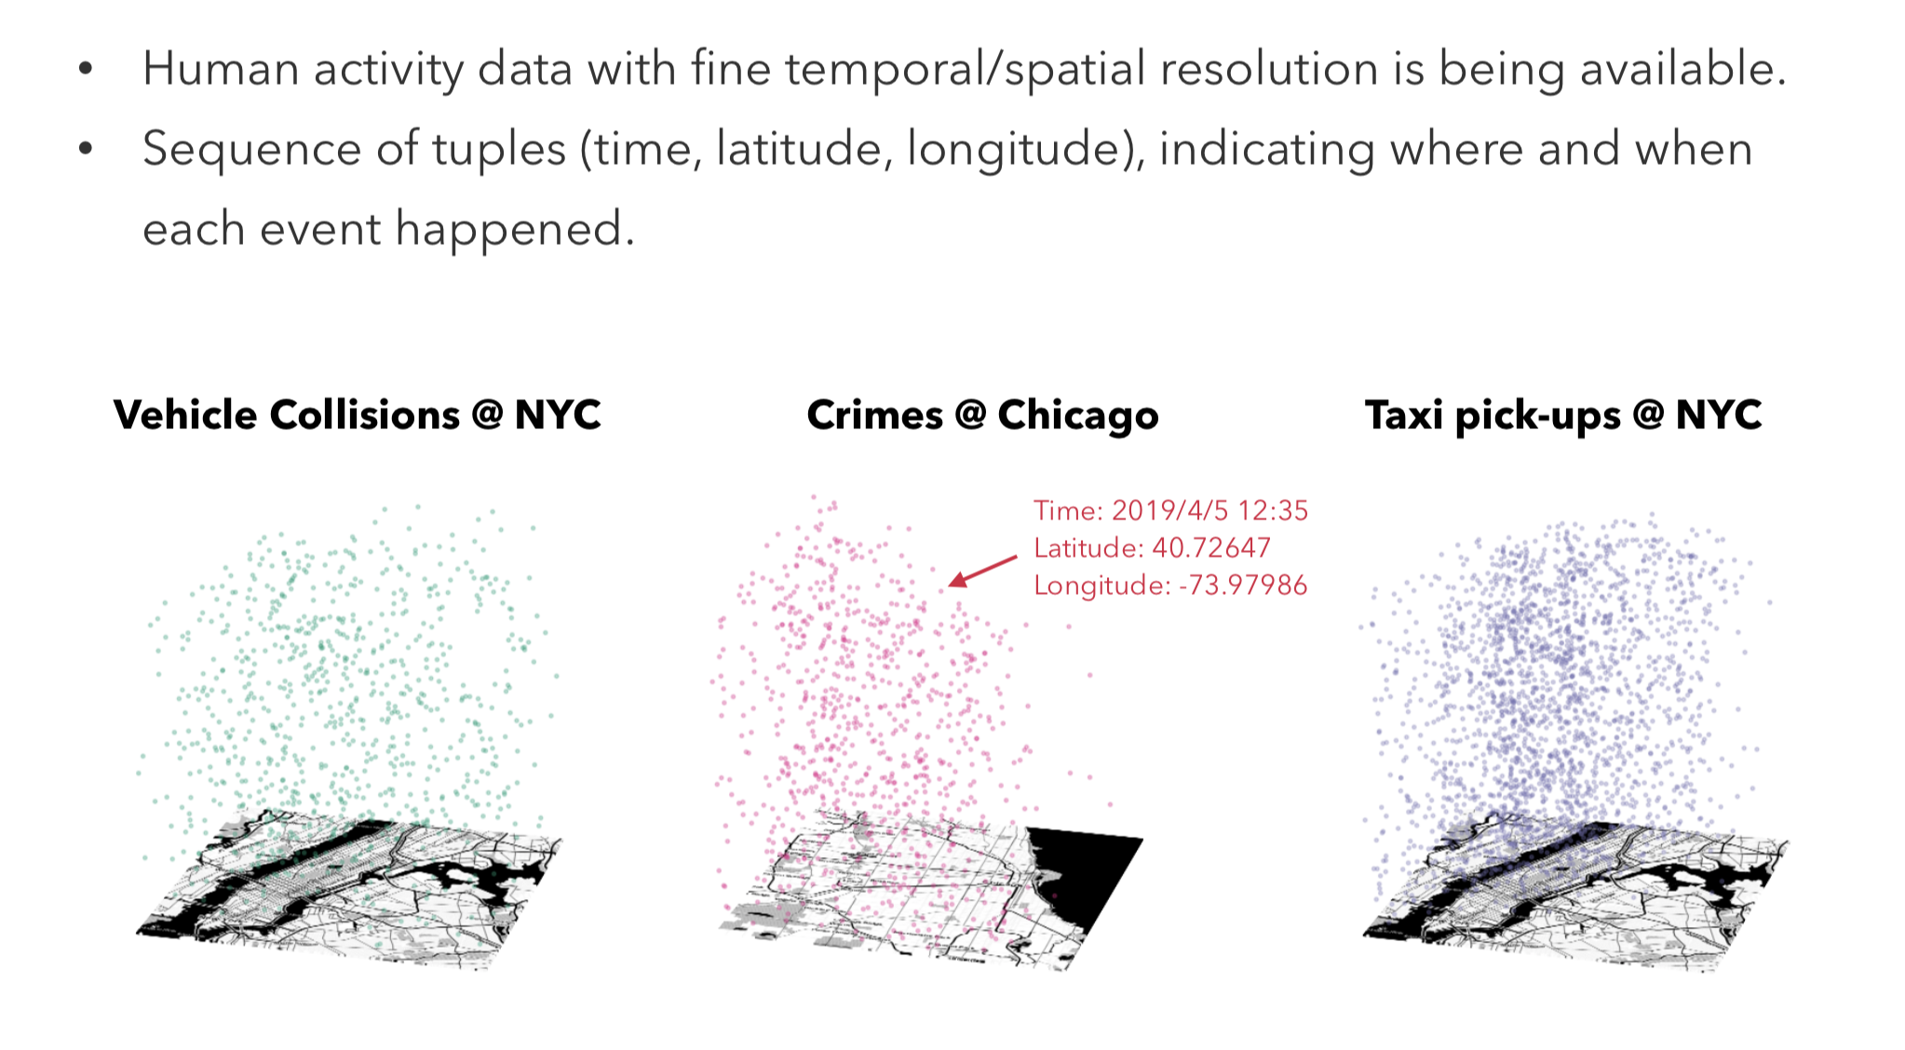
What is event data?

Slide 17
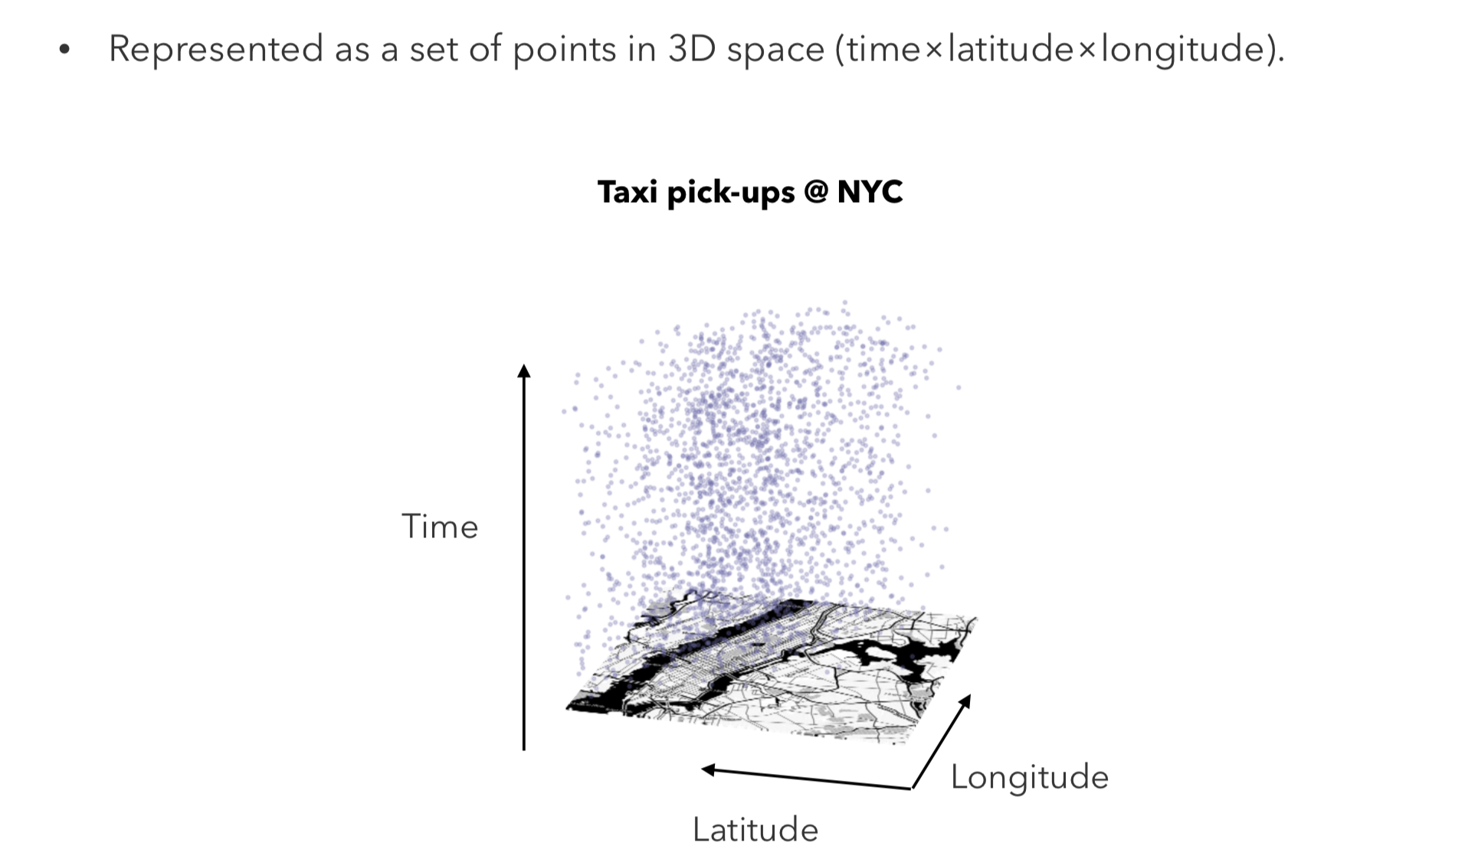
What is event data?

Slide 18
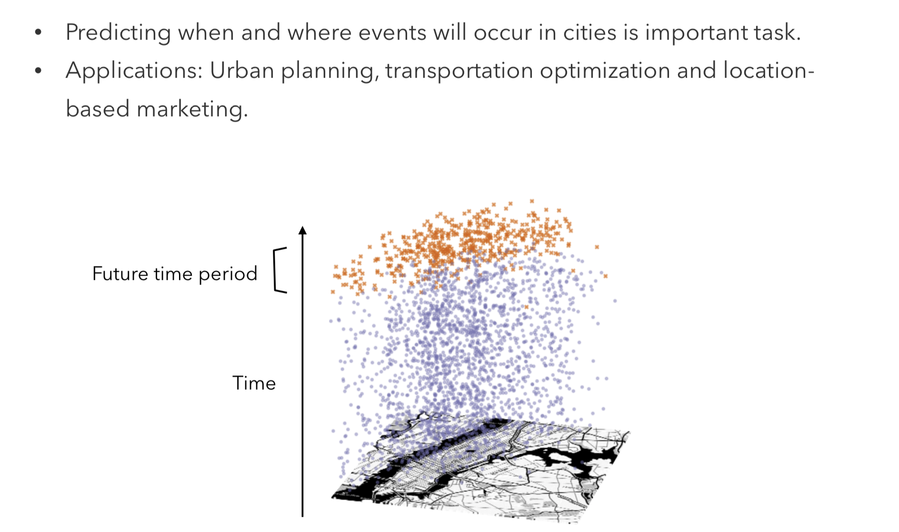
Event prediction

Slide 19
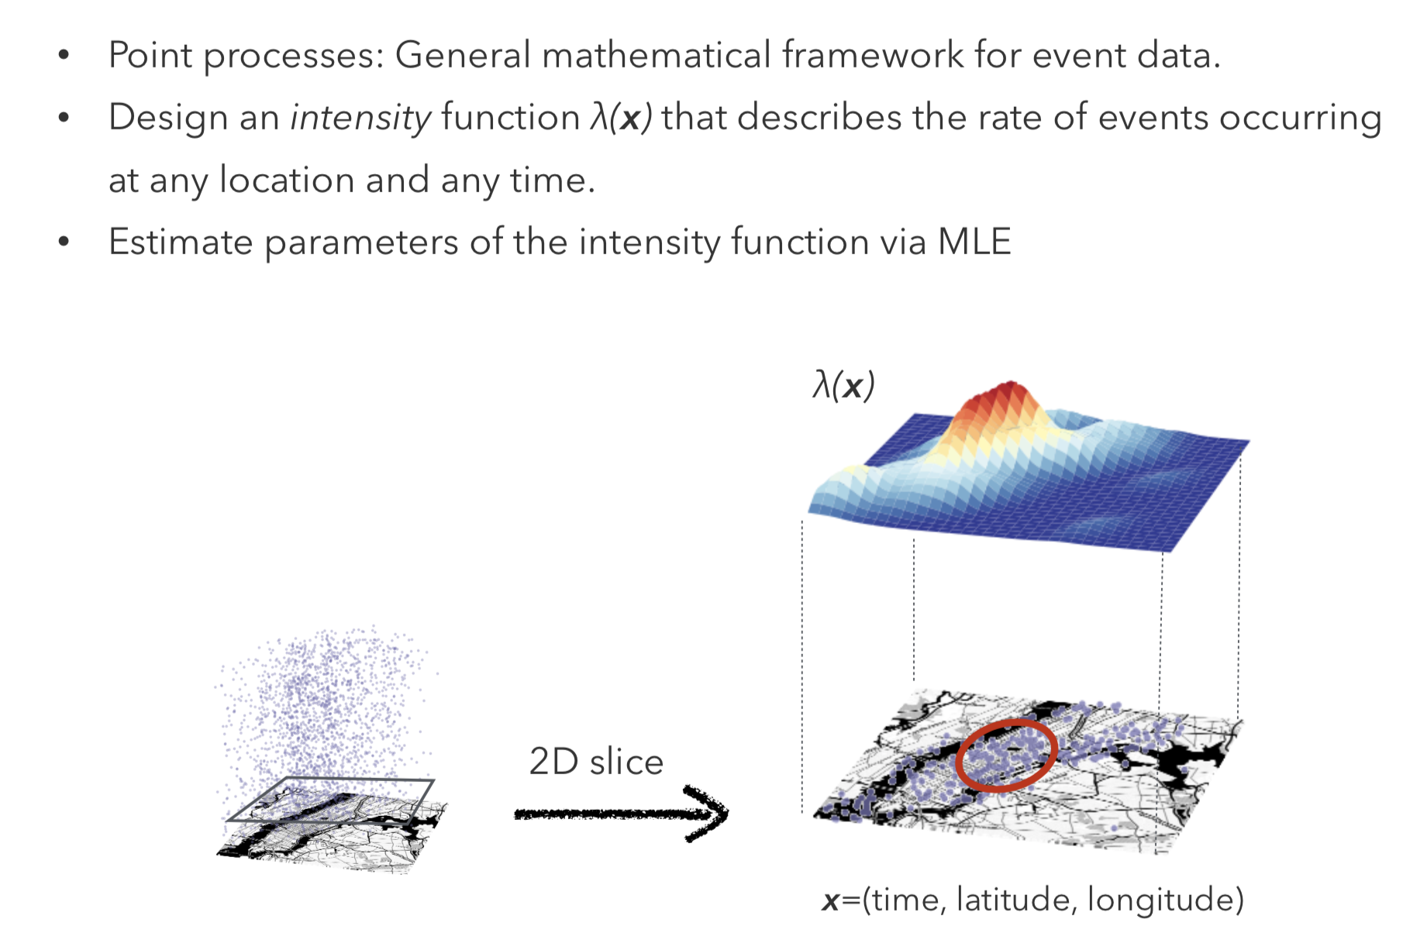
Conventional Approach

Slide 20
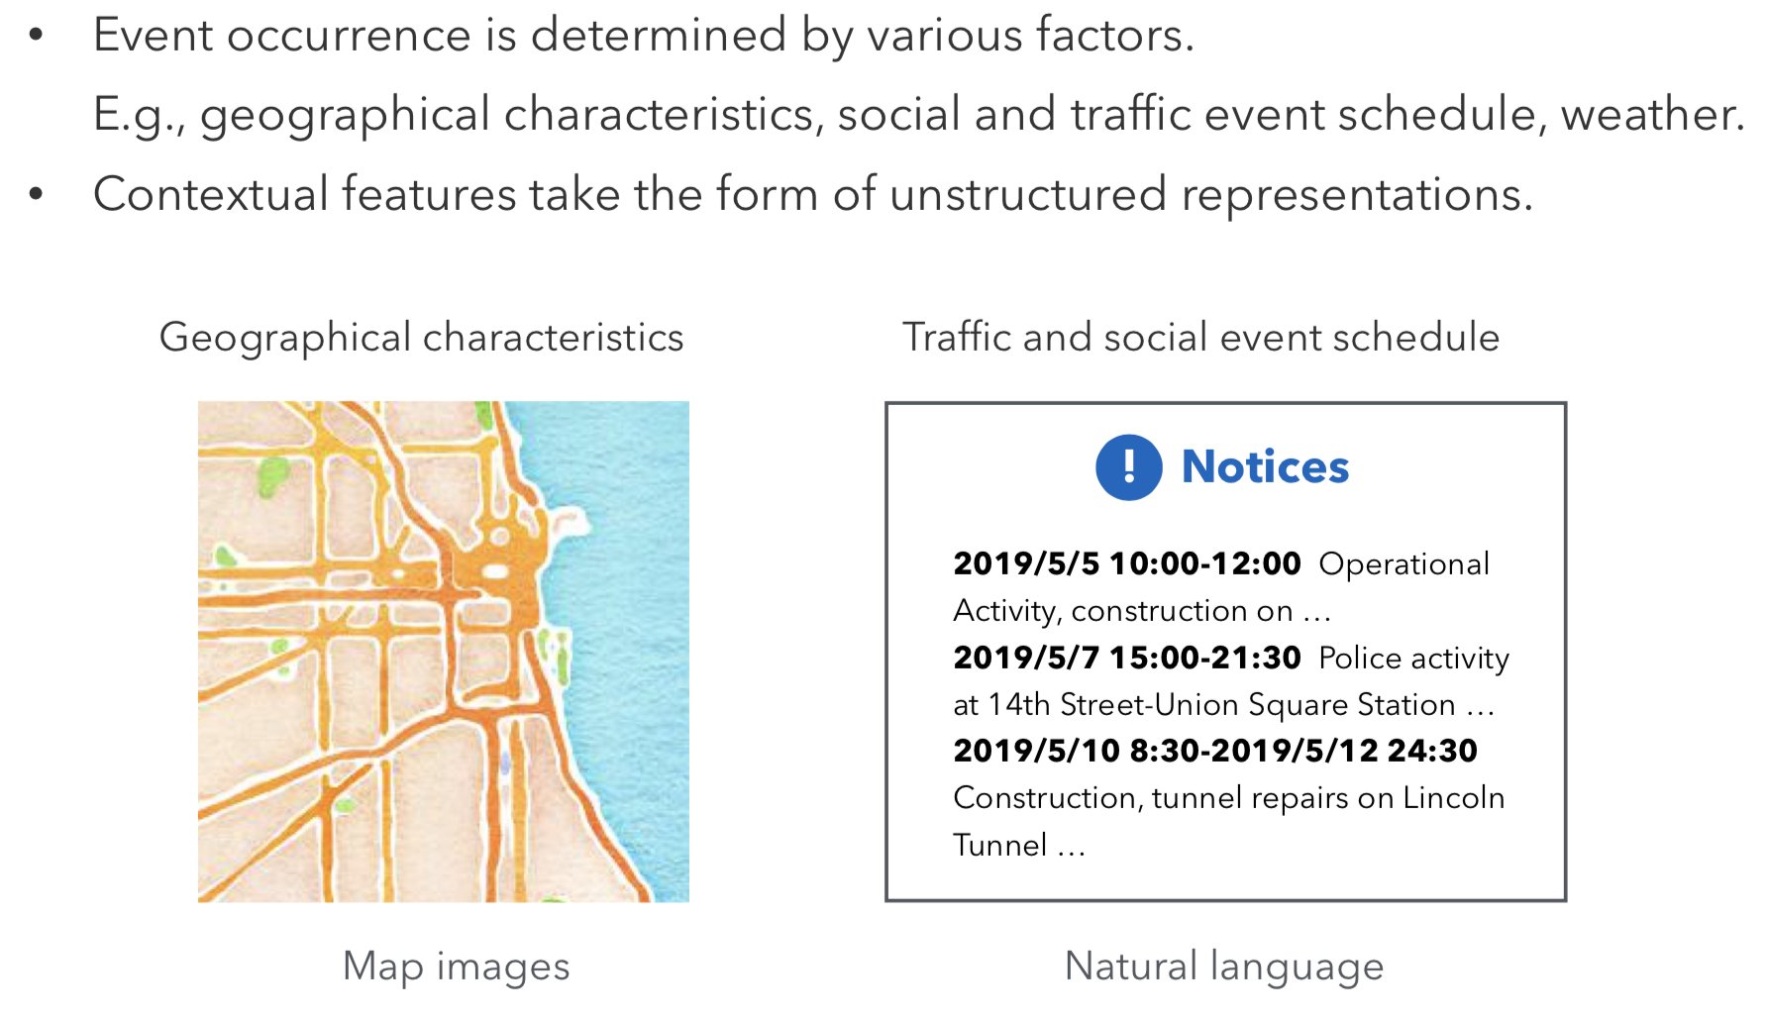
Challenge

Slide 21
OUTLINE
Preliminaries
Motivation
Method
Experiment

Slide 22
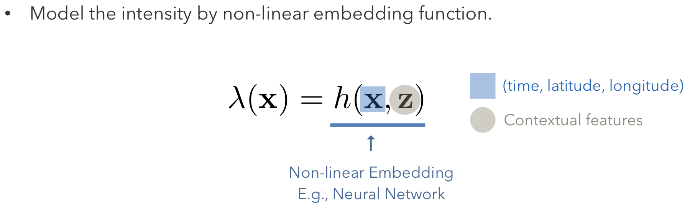
Naive Approach

Slide 23
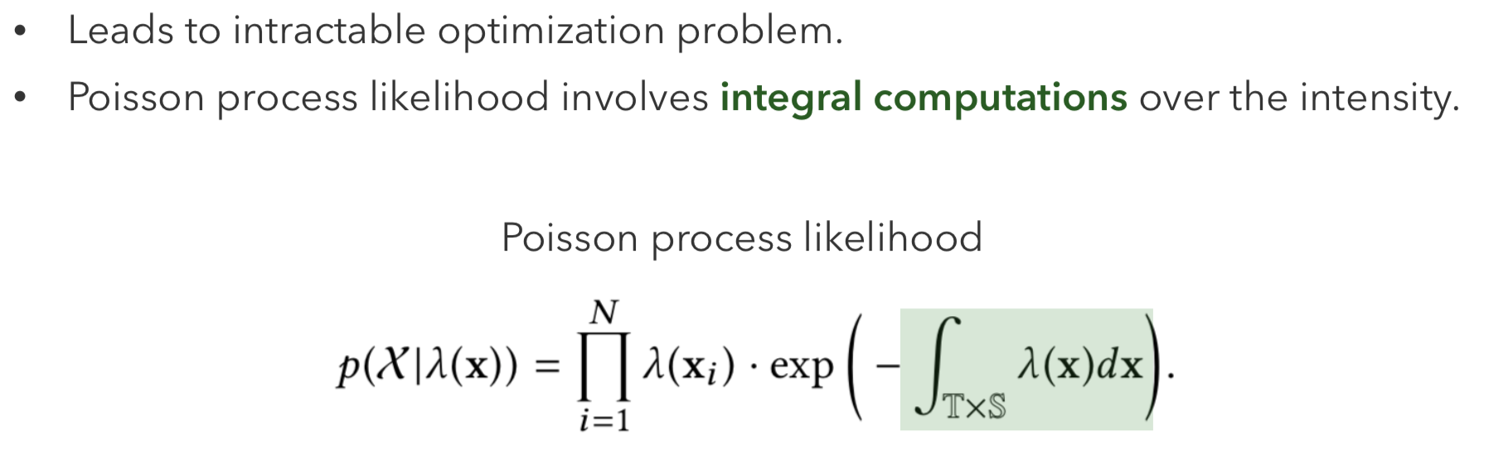
Naive Approach

Slide 24
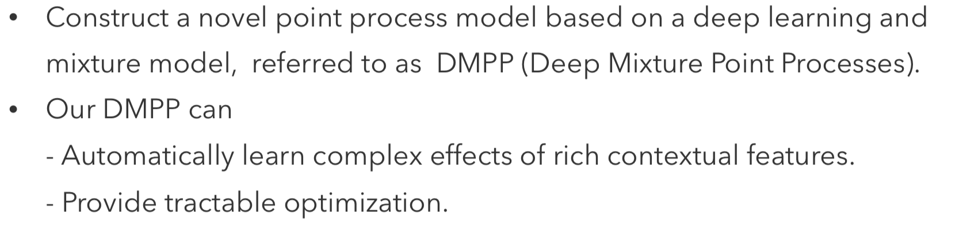
Deep Mixture Point Processes

Slide 25
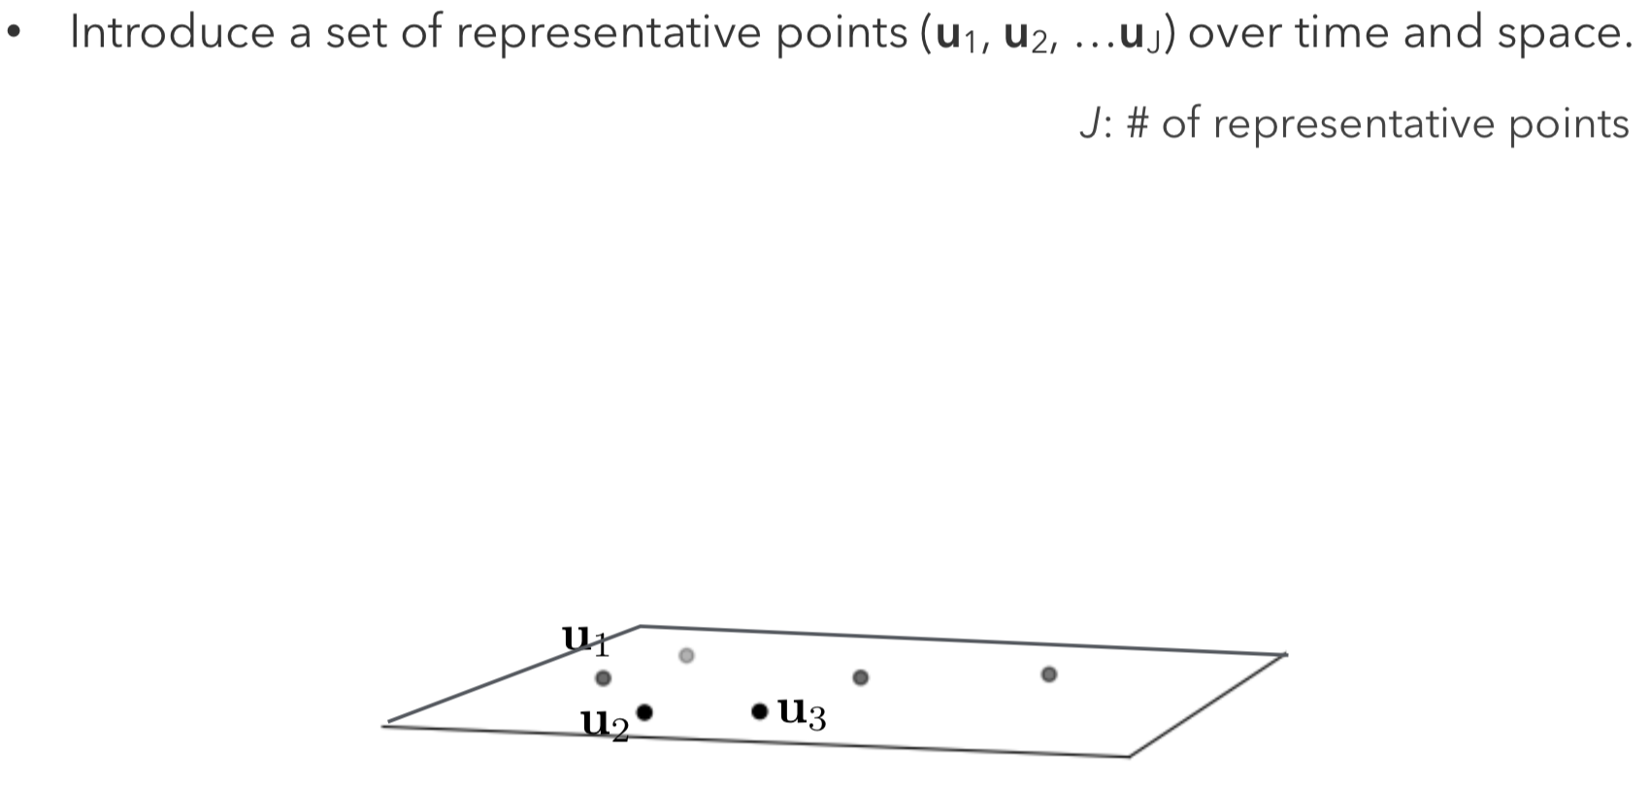
DMPP

Slide 26
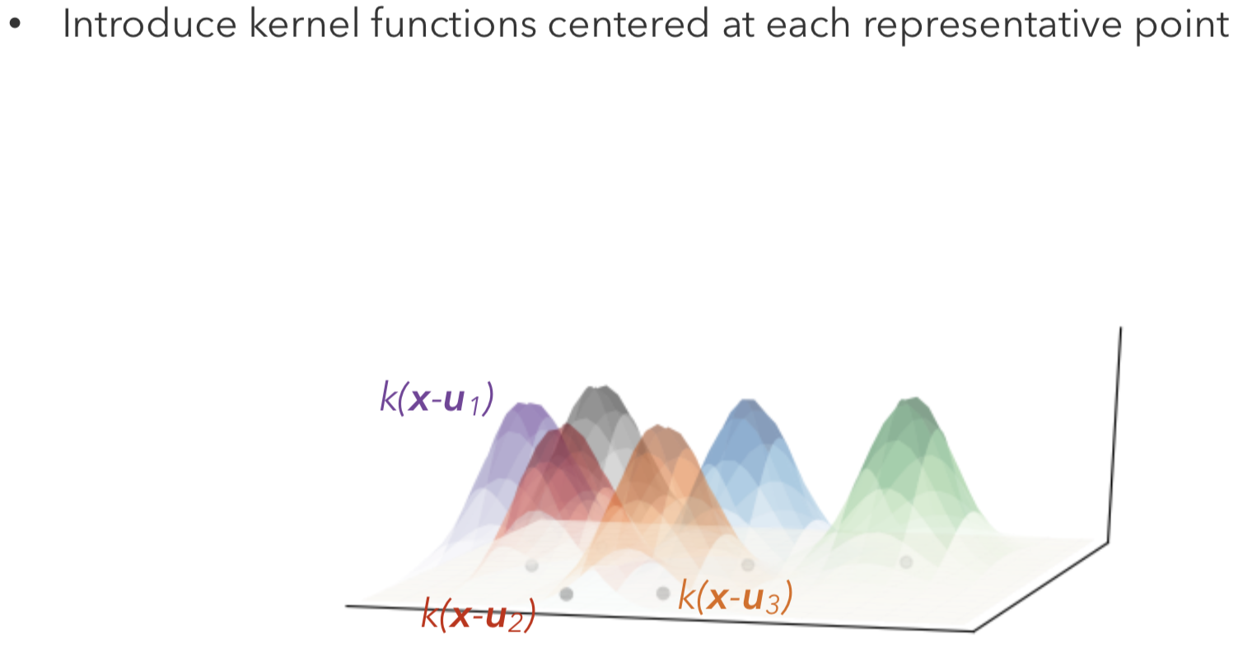
DMPP

Slide 27
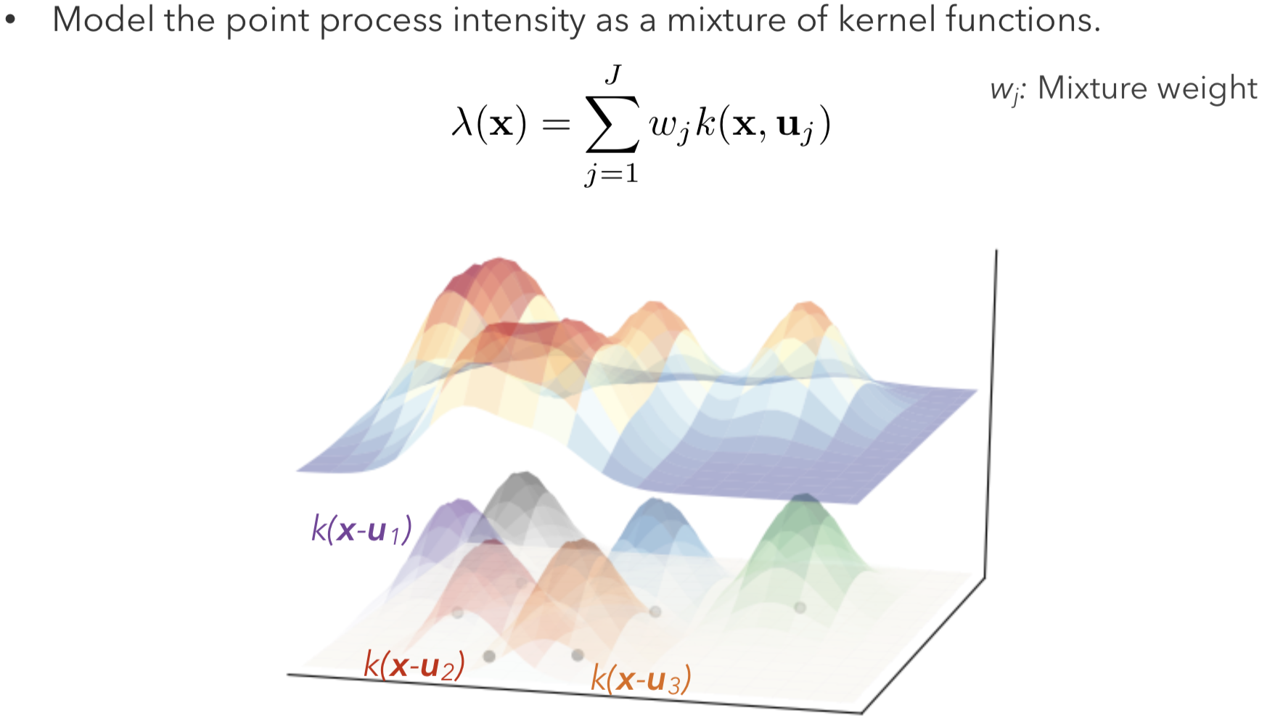
DMPP

Slide 28
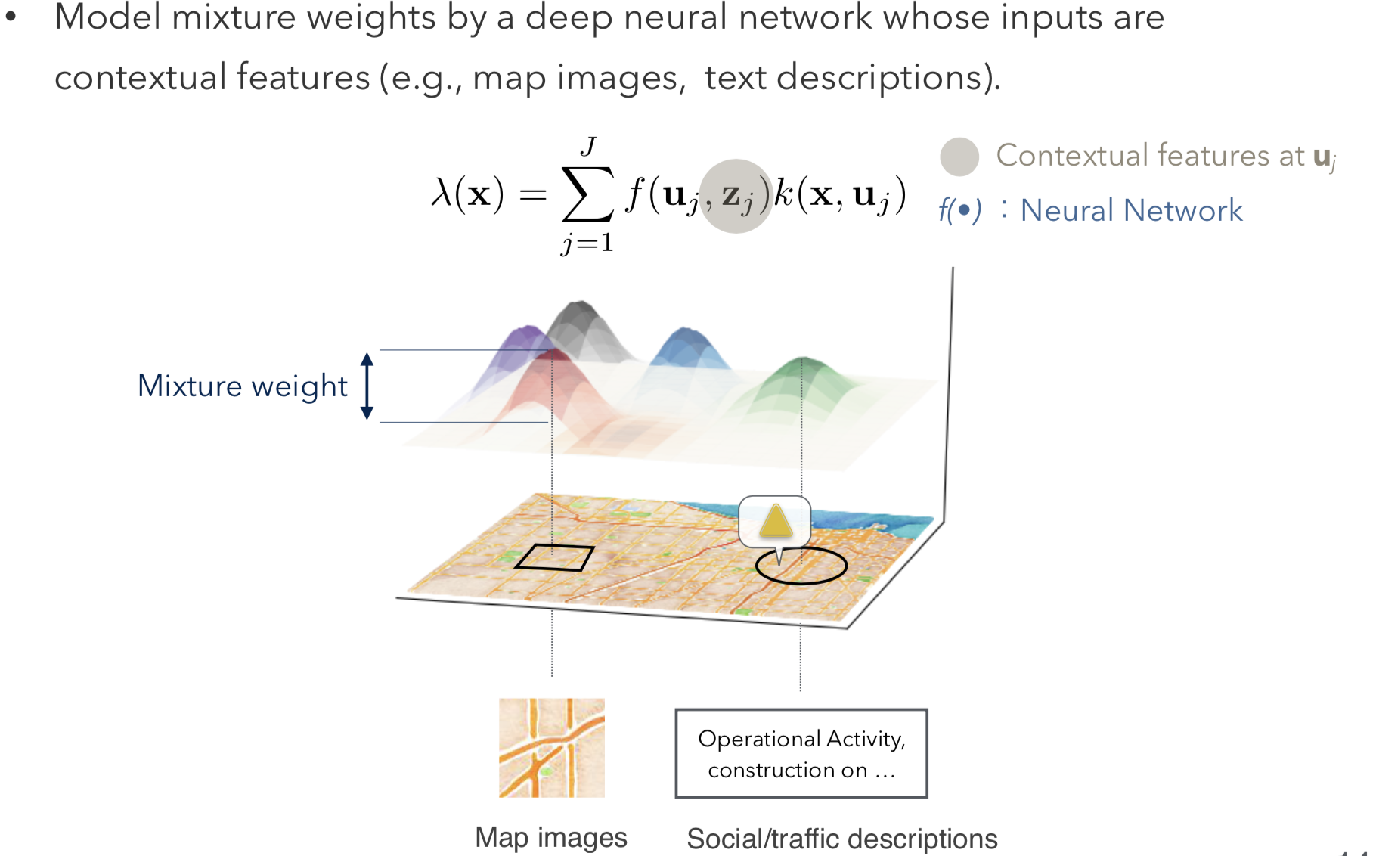
DMPP

Slide 29
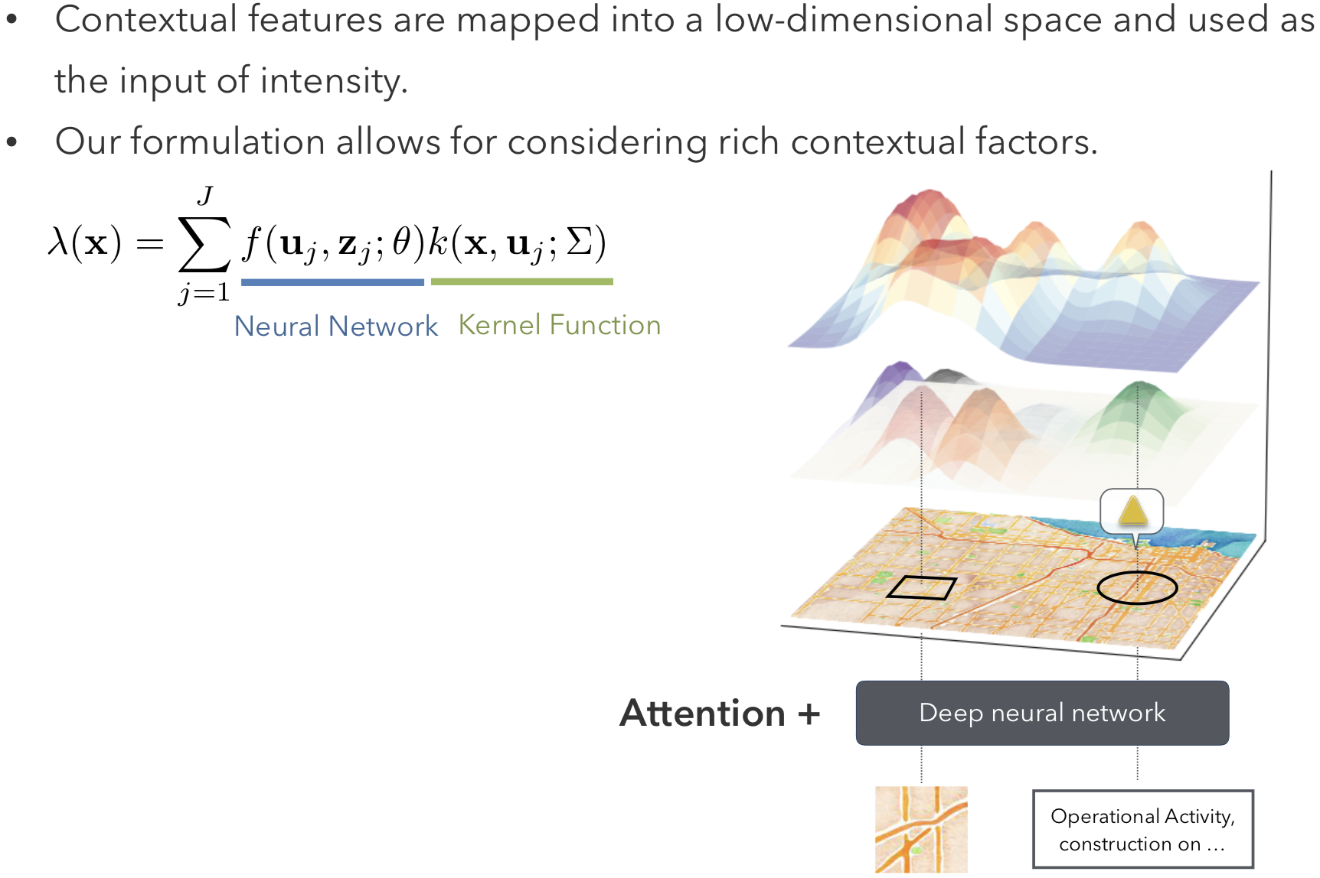
Proposal: Deep Mixture Point Processes

Slide 30
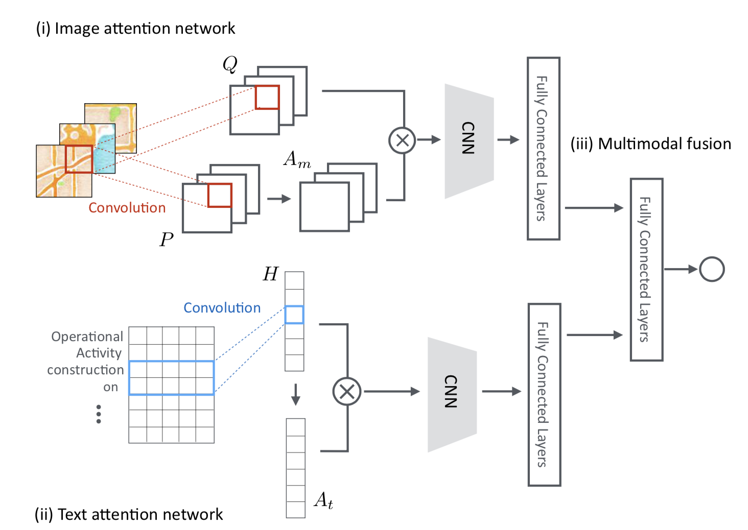
Neural Network Architecture

Slide 31
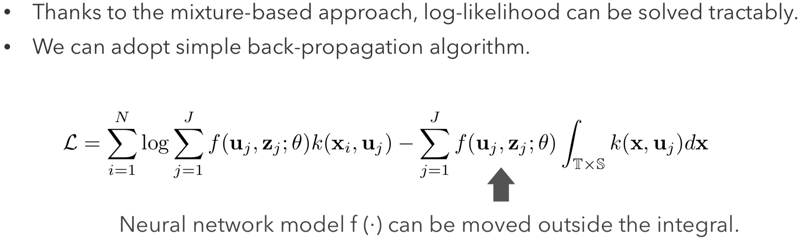
Parameter Learning

Slide 32
OUTLINE
Preliminaries
Motivation
Method
Experiment

Slide 33
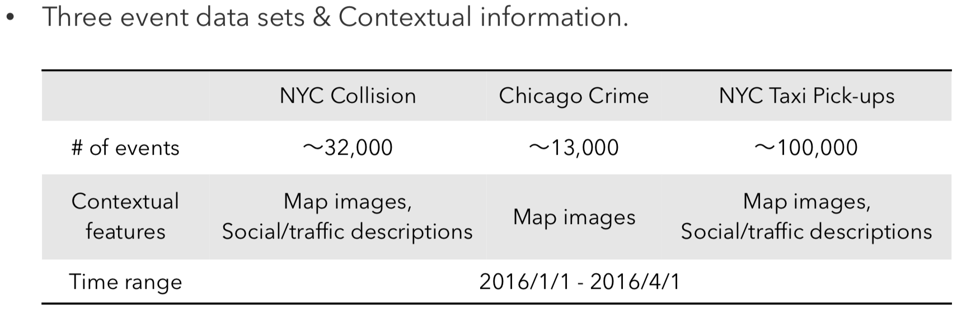
Dataset
HP (Homogeneous Poisson process)
LGCP (LogGaussianCoxprocess )
RMTPP (Recurrent Marked Temporal Point Process)

Slide 34
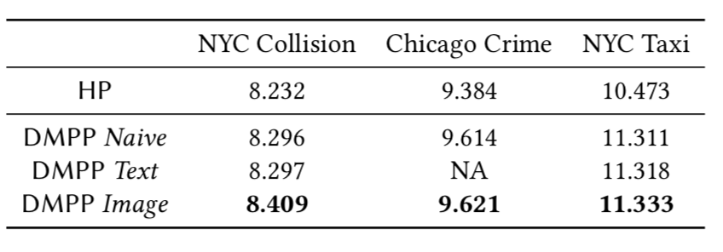
log-likelihood value
no text data is available for Chicago

Slide 35
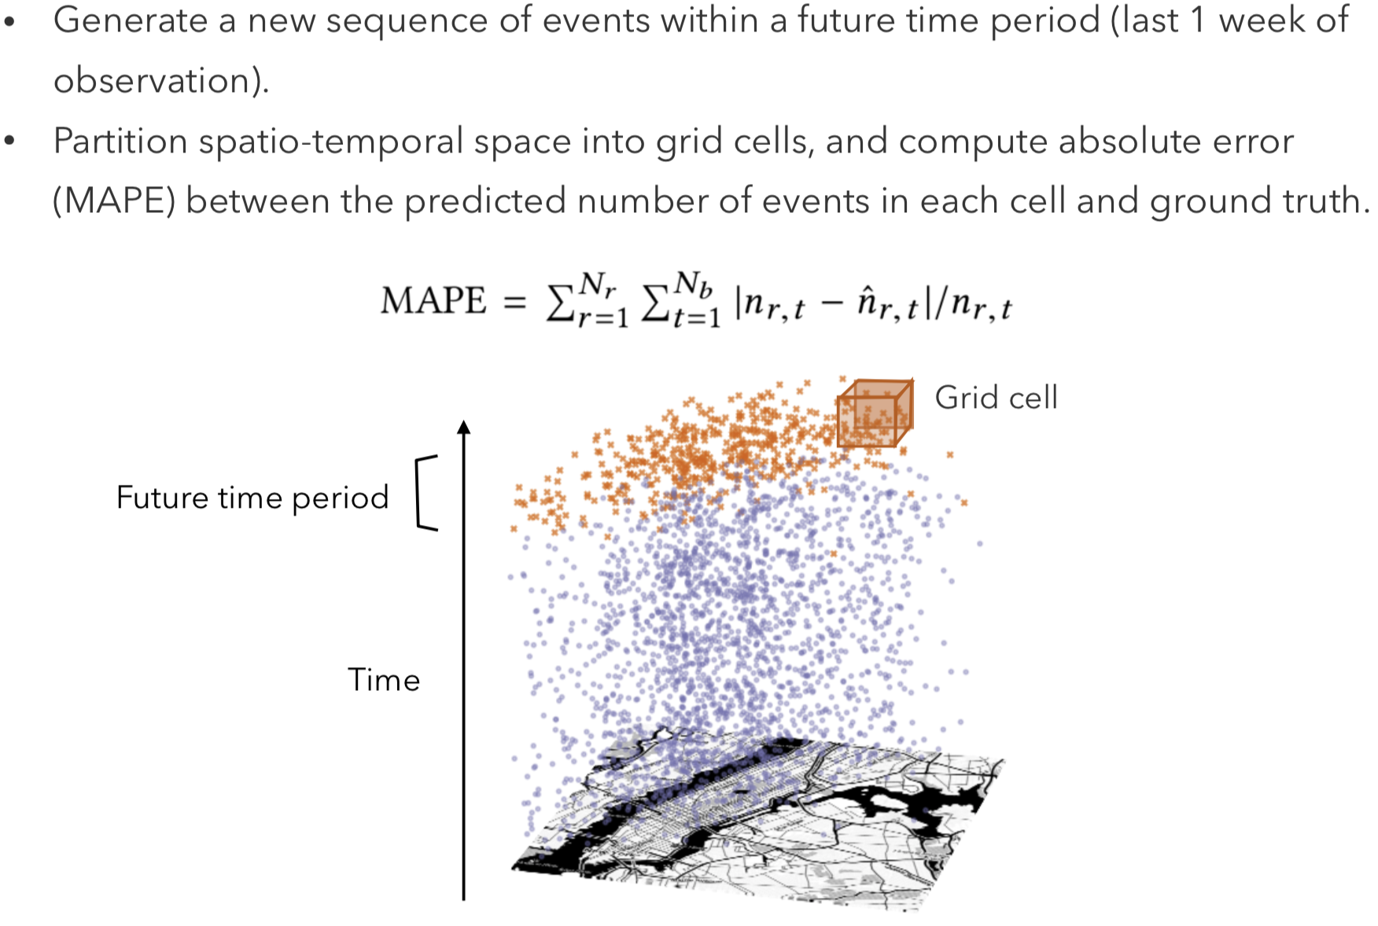
Evaluation protocol

Slide 36
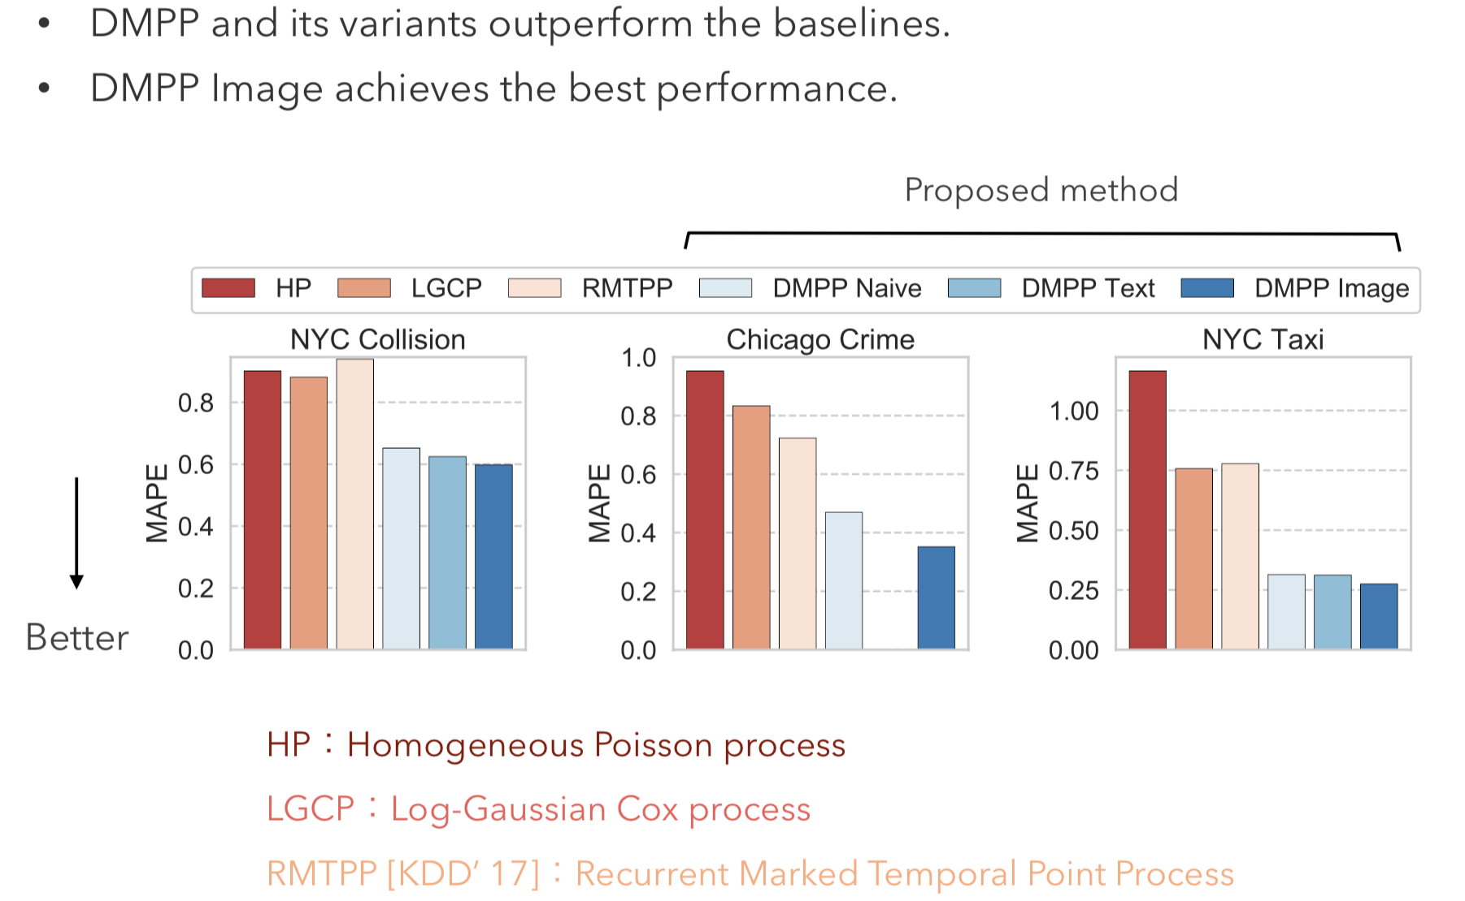
MAPE for event number prediction

Slide 37
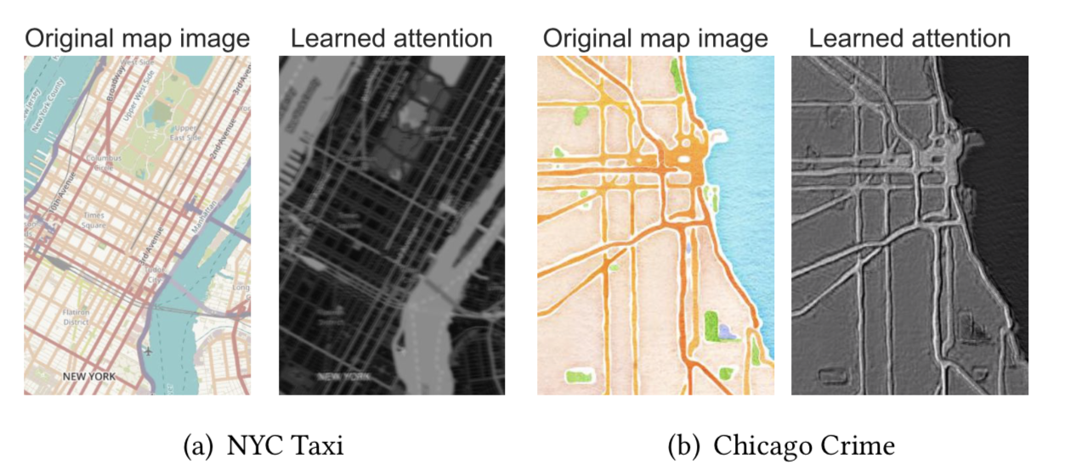
Attention weights for the map images
DMPP assigns high attention weights to major roads (depicted by pink for the NYC Taxi and minor roads draw less attention.
For Chicago Crime, the attention mechanism weights both the roads and land cover.

Slide 38
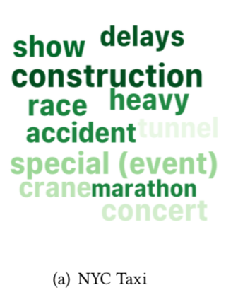
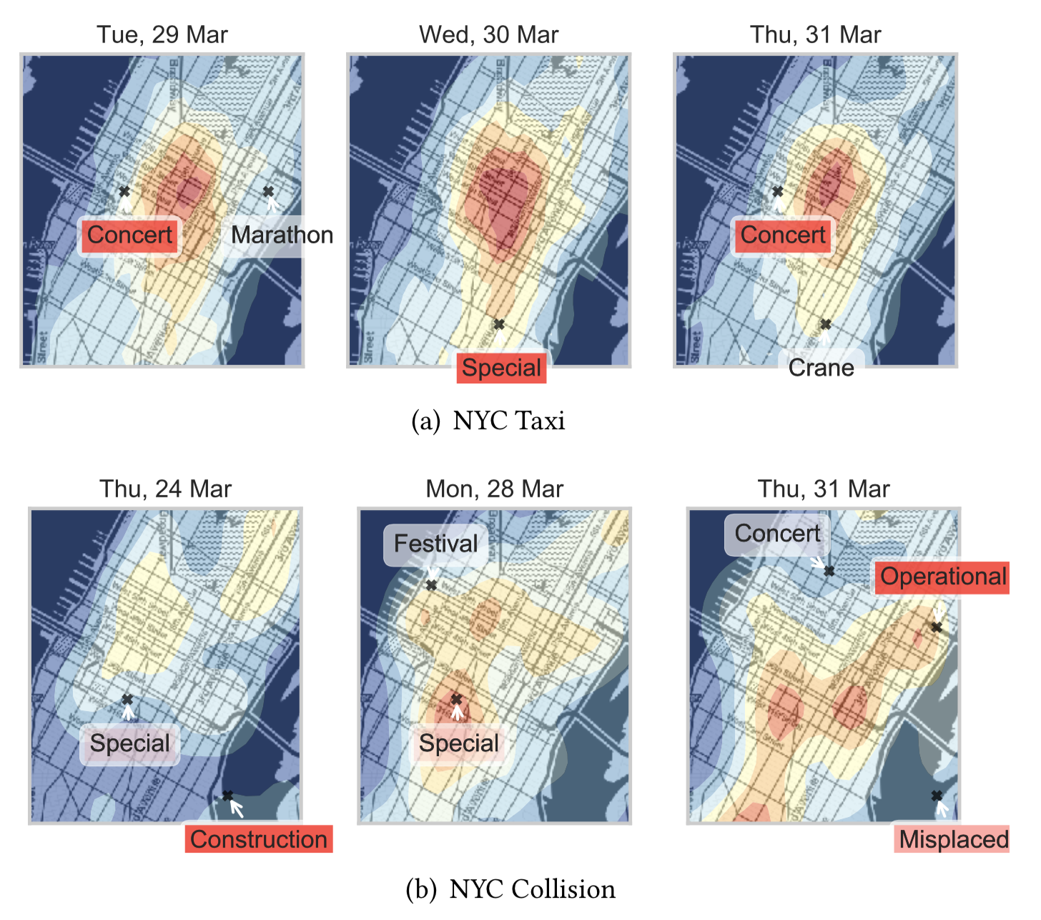
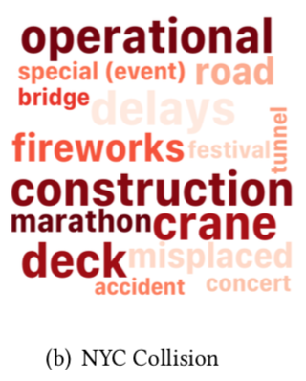
Attention weights for texts
Words related to the social events, e.g., Concert and Special (event), are highlighted.
words associated with traffic events, such as Construction and Operational (activity), gain more attention
Notes:
词云是两个数据集中attention值最大的15个词语
DMPP确实找到了影响事件发生的词语，这能够帮助我们理解为什么在某个地点事件发生的强度会很大

Slide 39
Summary
DMPP models the point process intensity by a deep mixture of kernels.
Utilize the unstructured data provided by rich urban contexts, including images and sentences.
Automatically discover their complex effects on event occurrence.
Being tractable.
Using real-world data sets, we demonstrated that the proposed method has better prediction ability than existing methods.

